Slide 1
Paying for College
Brittany Washington
Advisor, Financial Aid

Slide 2
What is Financial Aid?
Financial Aid - is any grant, loan, scholarship, or paid employment offered to help a student meet their college expenses.

Slide 3
FSA ID – FAFSA Only fsaid.ed.gov
We recommend all students and parents who are completing a FAFSA to create an FSA ID.
The FSA ID allows for the student and parent to electronically sign the FAFSA.
Name
Social Security Number
Personal mobile number and/or email address

Slide 4
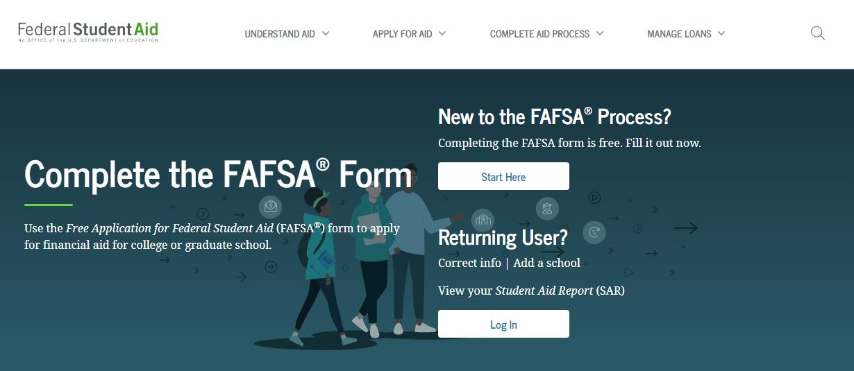
FAFSA
2023 - 2024 Aid year
Application will be available
October 1st 2022– June 30th 2024
(2021 taxes)
https://studentaid.gov/
School Code: 003609

Slide 5
What will you need to apply?
Parent Tax Return and W2’s
Student Tax Return and W2’s
Student Social Security Number*
Parent Social Security Number*
Student’s State ID/ Driver’s License
Parent and Student – FSA ID and Password
https://fsaid.ed.gov
* Name must match what is listed on Social Security card

Slide 6
No Parent Social
If the parent does not have a social security number the student will enter 9 zeros in the section for parent’s social.
The parent will have to physically sign the FAFSA signature page.
The signature page can be mailed to the Dept of Ed or submitted to San Jacinto College.
  San Jac will accept the Dept of Ed signature page or the San Jac signature page.
  The Dept of Ed will only accept their official form.

Slide 7
TASFA
TASFA is an application for state funded assistance for students that may be undocumented.
Student must have graduated high school in the United States and must complete a SB1528 affidavit.
Students will need to provide:
Parent Tax Return and W2’s
Student’s Tax Return and W2’s

Slide 8
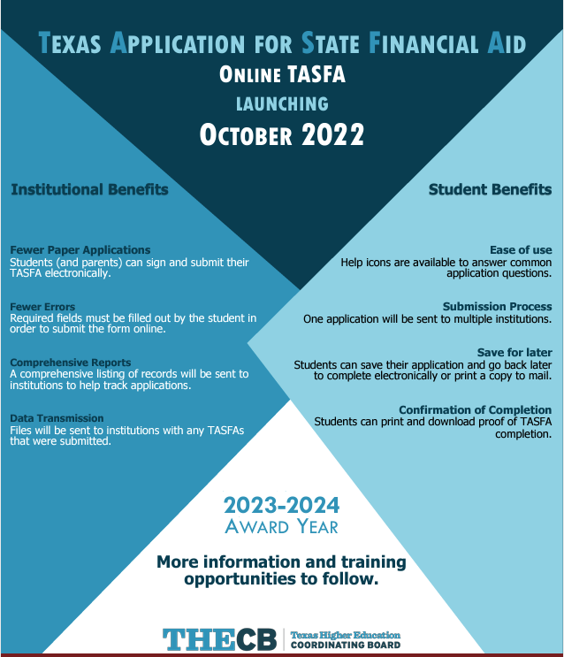
No more paper TASFA
The TASFA is going to an online submission portal for the 2023 – 2024 award year.

Slide 9
Dependency Status?
Dependent Student
Independent Student
Under 24 years old
Not married
No children or legal dependents
Have Children
Legal Dependent
Orphan, Ward of the Court, Foster Care
Emancipated Minor
Legal Guardianship
Unaccompanied Youth

Slide 10
Extenuating Circumstances
If a student is facing extenuating circumstances, there is a review process.
Examples:
    Student does not live with parents.
    Lost of income (Student or Parent)
    Death of parent

Slide 11
Types of Aid
Grant - is money the government provides for students who need it to pay for College, Grants do not have to be repaid*.
Scholarships – (merit or need based) money awarded to students to help pay for tuition, books, and living expenses, scholarships do not have to be repaid*.
Work Study - provides part-time jobs for undergraduate and graduate students with financial need, allowing them to earn money to help pay education expenses.
Student Loans - help student pay for tuition, books, and living expenses, loans do have to be repaid.

Slide 12

How to maintain eligibility
Must maintain a cumulative 2.0 GPA.
75% pass rate overall.
Must re-apply every year to continue to receive Financial Aid.
Warning Status - First semester not meeting qualifications, student is still eligible for Financial Aid.
Suspension Status - Second semester not meeting qualifications, student is no longer eligible for any type of Financial Aid.

Slide 13
Q&A?
Financial Aid Office
https://studentaid.gov/
San Jacinto College School Code: 003609

